Slide 1


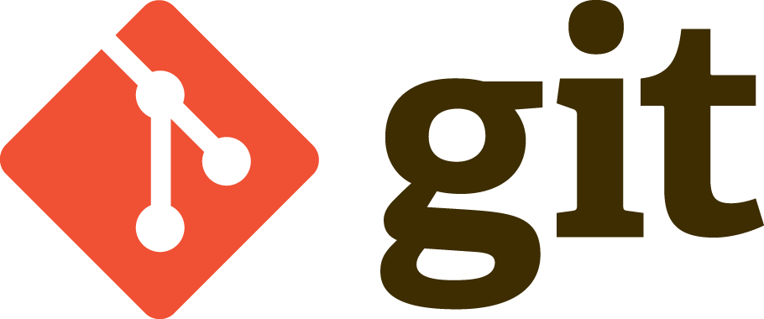
Version control systems
Version control system (VCS) is a system that records changes to a file or set of files over time so that you can recall specific versions later.
It allows you to revert files back to a previous state, revert the entire project back to a previous state, compare changes over time, see who last modified something that might be causing a problem, who introduced an issue and when, and more.

Slide 2
Local VCS, Distributed VCS
Local VCS
Simple commands
Checkout by parts
You need more frequent connection to central server
Distributed VCS
View history on local machine
You can work locally more
You can not create empty folders

Slide 3
Local version control systems
RCS, which is still distributed with many computers today. Even the popular Mac OS X operating system includes the rcs command when you install the Developer Tools. RCS works by keeping patch sets (that is, the differences between files) in a special format on disk; it can then re-create what any file looked like at any point in time by adding up all the patches.
Centralized Version Control Systems (CVCS) - these systems, such as CVS, Subversion, and Perforce, have a single server that contains all the files versions, and a number of clients that check out files from that central place.

Slide 4
Distributed Version Control Systems
In a DVCS (such as Git, Mercurial, Bazaar or Darcs), clients don’t just check out the latest snapshot of the files: they fully mirror the repository. Thus if any server dies, and these systems were collaborating via it, any of the client repositories can be copied back up to the server to restore it. Every clone is really a full backup of all the data.

Slide 5
GIT frequent commands
Create repositories
To create a new local repository with the specified name
$ git init [project-name]
To download a project and its entire version history
$ git clone [url]
https://github.github.com/training-kit/downloads/github-git-cheat-sheet.pdf

Slide 6
GIT frequent commands
Make changes
Lists all new or modified files to be commited
$ git status
Shows file differences not yet staged
$ git diff
Snapshots the file in preparation for versioning
$ git add [file]
Records file snapshots permanently in version history
$ git commit -m "[descriptive message]"
https://github.github.com/training-kit/downloads/github-git-cheat-sheet.pdf

Slide 7
SVN frequent commands
Create repositories
To create a new local repository with the specified name
$ svnadmin create /[svnrepos]
Import your project
$ svn import /projects/myrailsproject file:///svnrepos/myrailsproject
https://backlog.com/git-tutorial/reference/commands/

Slide 8

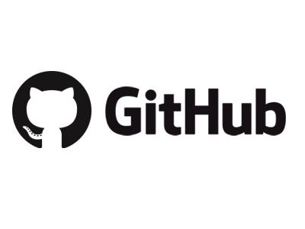


Open VCS services

Slide 9
GitLab
“In GitLab, you can create projects for hosting your codebase, use it as an issue tracker, collaborate on code, and continuously build, test, and deploy your app with built-in GitLab CI/CD.
Your projects can be available publicly, internally, or privately, at your choice. GitLab does not limit the number of private projects you create.”
https://docs.gitlab.com/ee/user/project/wiki/

